Slide 1


Telecom Churn Dashboard

Slide 2
About the dataset
A Telecom Company facing a lot of customer churning, provides it’s customer data to analyse it and provide some recommended analysis.
The Data contains around 7000 rows and 39 columns to analyse .
A Telecom Customer Company providing a data related to their customers (Data Source- Maven Analytics). The data includes, Customer ID, demographic information of the customers, and various services used by the customer, customer’s monthly charges and average revenue generated by the customer, also provide data about customer’s status i.e. Churned, Stayed, Joined.
From this data we have to find out the useful information that helps us to identified that how many customer joined the company? And also find out the customer profile for a customer that churned, joined, and stayed?

Slide 3
Methodology & Project scope
From this data set our final motive is to find out some questions , and with the help of analysis it is easy to us . With the help of Excel we will do some Calculation, and make data Understandable.
In the starting we will arrange the 3 data sheet in one one excel book . That help us to find information in one book
After arranged the sheet we will do some basics operation, like find out the blanks cells, Duplicate values that helps us to understand data.
Important information is given in Data dictionary. Which contains 3 columns and a lot of important information about the data.
After reading the Data dictionary , I will use the Pivot table to generated the information . and also use of slicers , and also perform the operations.
In the last step Visualization is generated right after the pivot table and also answered some of the important questions of my analysis.

Slide 4
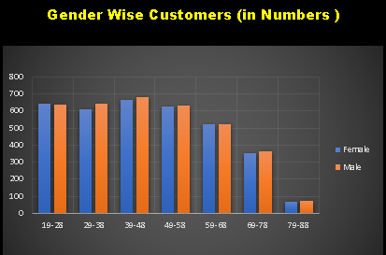
How many customers joined the company?
This analysis is done with the help of the pivot table and this graph shows the total number of the Male and Female.
Also this graph represent the age group of the male and female.
With the help of this analysis , it is easy to understand the age group of the customer .

Slide 5
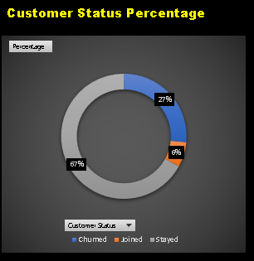
What is the customer profile for a customer that churned, joined, and stayed? Are they different?
The Graph shows the total number of customer percentage.
As per the graph it is clear that the total percentage of the customer is 100%.
From which Churned is -------- 27%
Joined ----------- 6%
Stayed ---------- 67%
With this analysis it is easy to understand that the all Status of the Customer is totally different form each other

Slide 6
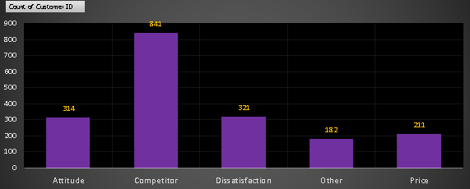
What seem to be the key drivers of customer churn?
From this graph the information is generated and the information is help us to identified the Key driver of customer churn.
The reason to do this analysis is to identified the cause why customer is left the company because the Competitor .
The range of the Competitor is 841. On the other hand the range of the Attitude is 314, then the range of the Dissatisfaction is 321, The range of the Other is 182, and the last , Price its range is 211.
The main reason that company lost his customer due to Competitor, and now company has to focused on this point that how company make better decision to save his customer .

Slide 7
Out of the 3 customer status, stayed, churned and joined, which has the highest %?
Out of these 3 Customer status the Stayed status has the Highest percentage 67%

Slide 8
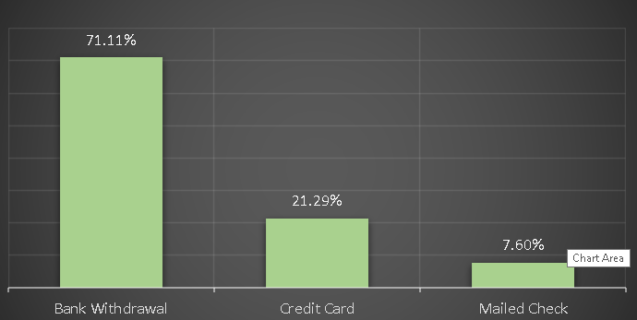
What payment method was preferred by churned users?
With the help of this analysis we clearly see that the best payment method preferred by Churned users is
Bank Withdrawal

Slide 9
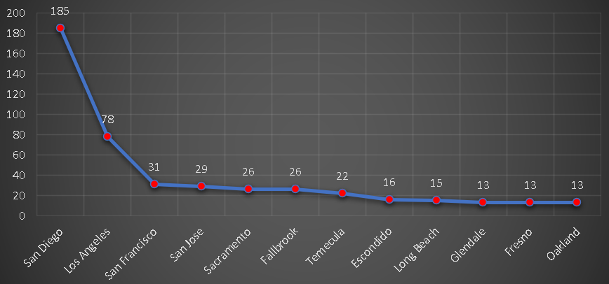
What are the top 12 cities that churned?
Graph shows the top 12 cities that Churned

Slide 10
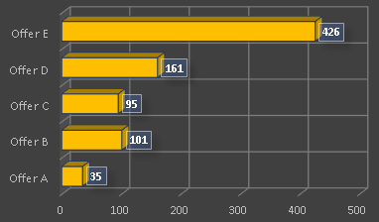
What churn offers were more preferable by the customers?
In the Churn Offer E were more Preferable by the Customers

Slide 11

Project Owner: Shubham koundal

